Slide 1
CSS
Cascading style sheet

Slide 2
CSS
CSS is the language we use to style and align our HTML elements.
CSS was introduced in 1994 by Haykon wium lie.
First version of CSS was introduced in 1996(CSS1)
CSS2-1998
Current version of CSS is CSS3-1999

Slide 3
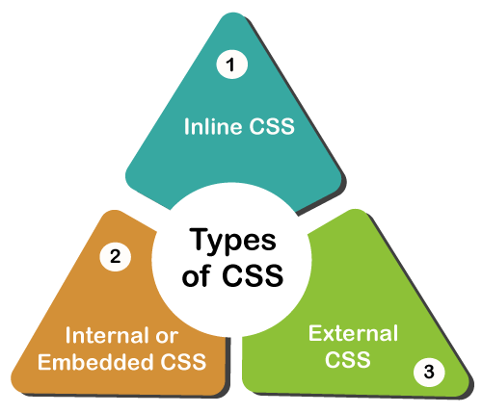
Types of CSS
It is style sheet language which is used to describe the look and formatting of documents written in markup language.
It is generally used with html to change the style of web pages and UI.
Commenting in css :-- /*-----*/

Slide 4
Syntax of css
Css syntax:- selector,property,value
| | |
P{ color: blue }

Slide 5
Three ways to add css file
1.Inline style sheet : Style attribute
<p style : ” color: red”>Hello CSS</p>
2.Internal style sheet : <style >tag
Example:
<style>
p{color : value}
</style>

Slide 6
External CSS Style
External style sheet==<link>tag
External css is used to apply css on multiple pages .
Extension must be .css for css files.
code
.CSS

Slide 7

Selectors

Slide 8
Types of CSS Selectors
Simple Selector
Combinator Selector
Pseudo class Selector
Pseudo Element Selector

Slide 9
Selector
A CSS selector selects the HTML element(s) you want to style.
Selector{
property: value;
property: value;
}

Slide 10
Simple Selector
Id selector (#)
Class selector (.)
Universal Selector (*)
Element Selector (tag)
Grouping Selector(,)

Slide 11
UNIVERSAL SELECTOR(*)
Select any and all types of elements in html page.
All the elements within a body tag.
Symbol of selector: “ * “
SYNTAX:
*{
properties }

Slide 12
TYPE/ ELEMENT SELECTOR
Selects particular element.
Call by type of tag.
SYNTAX:
element name{
properties
}

Slide 13
ID SELECTOR(#)
Unique id attribute within the page is selected
Core attribute selector
Selected by symbol “#” followed by id name
SYNTAX: #id_name{
css properties
}

Slide 14
CLASS SELECTOR
Core attribute selector ,with specific class.
The character to access in css file “ . “
Multiple class name can be called using comma
SYNTAX: . class _ name{
/* css properties*/
}
NOTE: PRIORITY ORDER =====
{ “ ID > CLASS > TYPE/ELEMENT >UNIVERSAL “}

Slide 15
Combinator Selector
Descendent selector(space)
Child selector(>)
Adjacent sibling selector(+)
General sibling selector(~)

Slide 16
DESCENDENT SELECTOR
A CSS selector can contain more than one simple selector. Between the simple selector we can use combinator
Combines two selector are such that elements are matched by second selector are selected if they have ancestor.
(parent,parents’s parent, parent’s parents’s parent)
Selector utilities a descendents combinator are called descendent selectors.
Syntax: Selector1_Selector2{property declaration}
Div p{ prop:val;}

Slide 17
Child selector(>)
The child selector selects all the elements that are the children of a specified element
It is placed between 2 CSS selectors,matches only those elements matched by second selector and direct child.
Syntax:
selector 1 > selector 2 { properties }
Ex:
Div>p{prop : val}

Slide 18
Adjacent sibling selector
The adjacent sibling selector is used to select an element that is directly after another specific element.
Sibling elements must have the same parent element, and "adjacent" means "immediately following".
Syntax :
former_element + target_element {style properties }

Slide 19
general sibling selector
The general sibling selector selects all elements that are next sibling of a specified element.
The general sibling combinator (~) separates two selectors.
Syntax :
former_element ~ target_element { style properties }

Slide 20
Pseudo classes
A CSS pseudo-class is a keyword added to a selector that specify a special state of the selected element.
For Example: It can be used to
Style an element when a user mouses over it
Style visited and unvisited links differently
Style an element when it gets focus
Selector:pseudo-class{
property:value;
}

Slide 21
Pseudo Classes
Dynamic pseudo classes
Anchor Pseudo-classes
    Link
    Visited
    Active
    Focus
    Hover
  Structural pseudo classes
    First-child
    Last-child
    Nth-child()

Slide 22
Psuedo ClASS SELECTOR
a:hover MUST come after we mouse hover on it
a:link and a:visited in the CSS definition in order to be effective.
a:active MUST come after
The :first-child pseudo-class matches a specified element that is the first child of another element.
The :last-child pseudo-class matches a specified element that is the last child of another element.
The :nth-child(n) selector matches every element that is the nth child of its parent.
n can be a number, a keyword (odd or even), or a formula (like an + b).

Slide 23
Pseudo Elements
A CSS pseudo-element is used to style specified parts of an element.
For example, it can be used to:
  Style the first letter, or line, of an element
  Insert content before, or after, the content of an element
selector::pseudo-element{
property:value;
}

Slide 24
Pseudo Elements
:: first-line
:: first-letter
::before
::after
::marker
::selection

Slide 25
Selector | Example | Example description
::after | p::after | Insert something after the content of each <p> element
::before | p::before | Insert something before the content of each <p> element
::first-letter | p::first-letter | Selects the first letter of each <p> element
::first-line | p::first-line | Selects the first line of each <p> element
::marker | ::marker | Selects the markers of list items
::selection | p::selection | Selects the portion of an element that is selected by a user

Slide 26
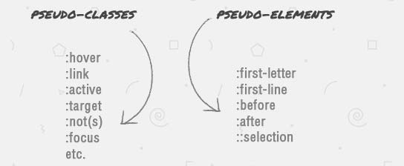
NOW WRITE THE DIFFERENCE BETWEEN
PSEUDO CLASS AND PSEUDO ELEMENT SELECTOR?!

Slide 27
Pseudo class v/s pseudo element
PSEUDO CLASS | PSEUDO ELEMENT
selectors are selected by “ : “ | selectors are selected by “ :: “
Pseudo-classes are used to target state. | Pseudo-elements are used to target specific parts of an element.

Slide 28
Text Property
Text formatting
  color
  Text-align
  Text-transform
  Text-shadow
  Text-decoration
  Letter-spacing
  Word-spacing

Slide 29
Background Property
Background-image : url (“image.jpg”)
Background-repeat : no-repeat/repeat-x/Y
Background-size : cover/100%
Background-Position : right/left/center
Background-attachment : scroll/fixed

Slide 30
Font Property
Font-size:large/small/medium
Font-weight:bold/bolder/lighter/normal
Font-style:italic
Font-family:font styles

Slide 31

Gradient:

Slide 32
Gradient:
Linear-gradient(direction,color-stop1,color-stop2);
Radial-gradient(shape size at position, start-color,…,last-color);

Slide 33
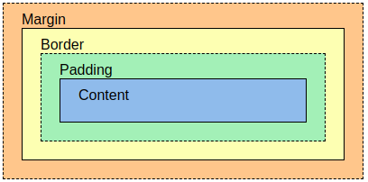
Box Model

Slide 34
Box model:
The CSS box model is essentially a box that wraps around every HTML element. It consists of: margins, borders, padding, and the actual content. The image illustrates the box model:
Content - The content of the box, where text and images appear
Padding - Clears an area around the content. The padding is transparent
Border - A border that goes around the padding and content
Margin - Clears an area outside the border. The margin is transparent

Slide 35
Properties
Margin-style
  Margin-top
  Margin-bottom
  Margin-left
  Margin-right
Padding-style
  Padding-left
  Padding-right
  Padding-top
  Padding-bottom
Border-style
  Border-color
  Border-width
  Border-radius

Slide 36
Position Property
Static
Relative
Fixed
Absolute
Sticky

Slide 37
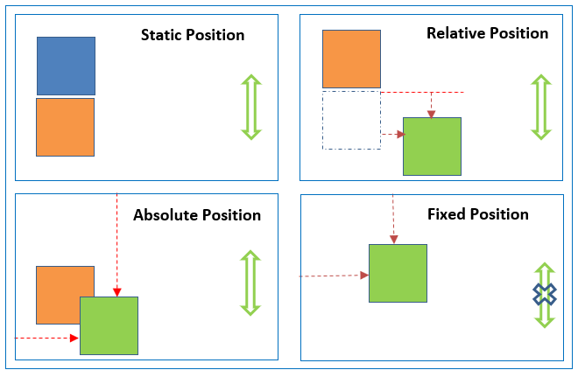

Slide 38
Display properties
Inline : Displays an element as an inline element (like <span>). Any height and width properties will have no effect
block : Displays an element as a block element (like <p>). It starts on a new line, and takes up the whole width
Inline-block : Displays an element as an inline-level block container. The element itself is formatted as an inline element, but you can apply height and width values
Flex : Displays an element as a block-level flex container

Slide 39
Flex Properties
Flex-box properties
Display : flex
Flex-direction: row/column
Flex-wrap: wrap/nowrap/wrap-reverse
Justify-content: flex-start/flex-end/center/space-around/space-between/baseline
Align-items: flex-start/flex-end/center

Slide 40
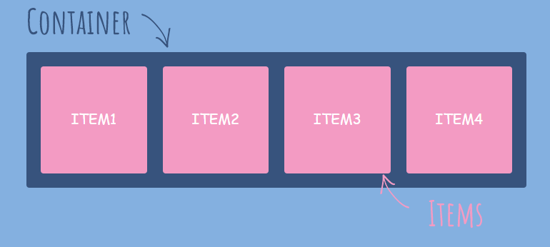
Flex-Box

Slide 41
Transition
Transition allows you to change property value.

Slide 42
Transition Property
CSS transitions allows you to change property values smoothly, over a given duration.
Transition-property: The CSS property you want to add
an effect to
Transition-duration: The duration of the effect
Transition-timing-function:
Transition-delay : The transition-delay property specifies a delay (in seconds) for the transition effect.
Transition(shorthand property)
  transition: width 2s linear 1s

Slide 43
Transition-timing-function
ease - specifies a transition effect with a slow start, then fast, then end slowly (this is default)
linear - specifies a transition effect with the same speed from start to end
ease-in - specifies a transition effect with a slow start
ease-out - specifies a transition effect with a slow end
ease-in-out - specifies a transition effect with a slow start and end

Slide 44
2D and 3D Transforms
Transforms allow you to move, rotate, scale, skew, element.

Slide 45
Transform property
The transform property applies a 2D or 3D transformation to an element. This property allows you to rotate, scale, move, skew, etc., elements.
It is used to change behavior of an element
2D transform :
        translate()
        rotate()
        scaleX()
        scaleY()
        scale()
        skewX()
        skewY()
        skew()
3D transform :
        rotateX()
        rotateY()
        rotateZ()

Slide 46
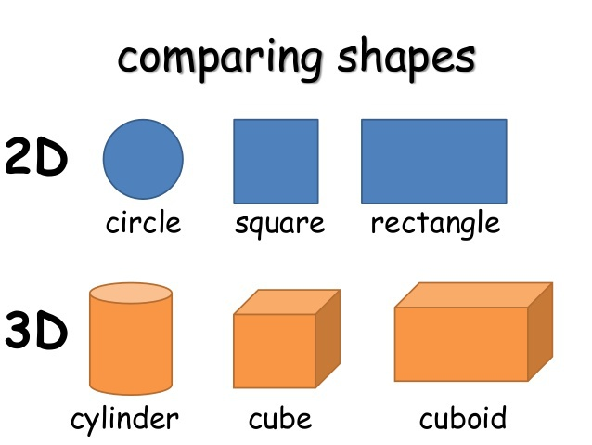
Difference

Slide 47
2D Transforms
1.translate()-moves an element from its current position.
2.rotate()-rotate an element clockwise/counter-clockwise according to degree.
Using negative values will rotate the element counter-clockwise.
3.scale()- increases/decreases the size of an element.
4.scaleX()-increases or decreases the width of an element.
5.scaleY()- increases or decreases the height of an element.
6.skew()-skews an element along the X and Y-axis by the given angles.
7.skewX()-skews an element along the X-axis by the given angle.[degree 0-360]
8.skewY()-skews an element along the Y-axis by the given angle.
9.matrix()- 6 parameters
mathematical function
matrix(scaleX(),skewY(),skewX(),scaleY(),translateX(),translateY())
transform: matrix(1, -0.3, 0, 1, 0, 0);

Slide 48
3D Transforms
rotateX()- rotates an element around its X-axis.
rotateY()-rotates an element around its Y-axis.
rotateZ()-rotates an element around its Z-axis.

Slide 49
Animations
CSS allows animation of HTML elements without using JavaScript
An animation lets an element gradually change from one style to another.
You can change as many CSS properties you want, as many times as you want.
To use CSS animation, you must first specify some keyframes for the animation.
Keyframes hold what styles the element will have at certain times.

Slide 50
ANIMATIONS
@keyframes
animation-name
animation-duration
animation-delay
animation-iteration-count
animation-direction
animation-timing-function

Slide 51
The @keyframes Rule
When you specify CSS styles inside the @keyframes rule, the animation will gradually change from the current style to the new style at certain times.
To get an animation to work, you must bind the animation to an element.
EXAMPLE :
@keyframes example {
from {background-color: red;}
to {background-color: yellow;}
}
/* The element to apply the animation to */
div {
width: 100px;
height: 100px;
background-color: red;
animation-name: example;
animation-duration: 4s;
}

Slide 52
animation-name :Name of the animation
animation-duration: This property defines how long an animation should take to complete, If the animation-duration property is not specified, no animation will occur, because the default value is 0s (0 seconds)
animation-delay : Property specifies a delay for the start of an animation.
animation-iteration-count : property specifies the number of times an animation should run.
animation-direction : property specifies whether an animation should be played forwards, backwards or in alternate cycles.
animation-timing-function: property specifies the speed curve of the animation

Slide 53
animation-direction
normal - The animation is played as normal (forwards). This is default
reverse - The animation is played in reverse direction (backwards)
alternate - The animation is played forwards first, then backwards
alternate-reverse - The animation is played backwards first, then forwards

Slide 54
Media queries
Media query is a CSS technique introduced in CSS3.
It uses the @media rule to include a block of CSS properties only if a certain condition is true.
In this example, the only keyword is used to target only screens.
Example
If the browser window is 600px or smaller, the background color will be lightblue:
@media only screen and (max-width: 600px) {
body {
background-color: lightblue;
}
}

